Slide 1

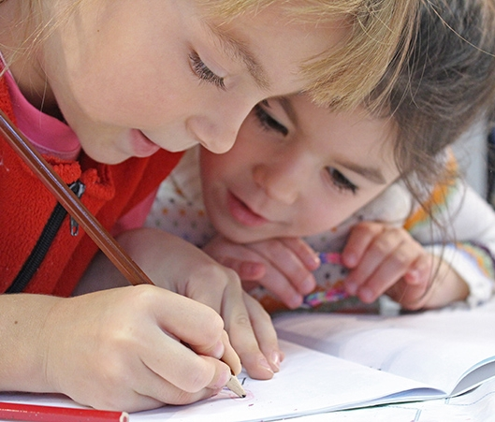

Math is Everywhere
Math is fun

Slide 2

Hello & Welcome
The focus of this presentation is to increase our confidence and capacity to help our children with math.
We can develop mathematical thinking through play and using everyday materials.
Math has a strong connection to literacy: books are a big part of understanding math.

Slide 3


Why is math so important?
Math is everywhere…
It is part of our everyday
lives
It promotes strong literacy
connections
It can affect our ability to
read

Slide 4
Everything we do is related to math
Telling time, cooking & eating, getting dressed, planning our life with calendars, etc. We use math everyday to solve problems and answer questions such as how many, how big, when and where. We use correspondence, measuring, classifying and sequencing daily.
This is true for children as well. Math helps children understand their world.

Slide 5
Books are a good way to explore math
Many children’s books are rich with math concepts (we need to think beyond the obvious numbers, shapes).
Think about the story Goldilocks and the Three Bears. There is a number in the title, but also the concept of ordering (sm. med. lg.), relationships, 1 – 1 correspondence, size, patterns, positions (on, under, over), and capacity (empty, full).

Slide 6
During school
Children learn the concepts and skills identified in the Ontario Mathematics curriculum in five major areas or strands of mathematics.
You will see these strands on a child’s report card.
We will spend the rest of this presentation looking at each strand and provide activities.

Slide 7
Math Strands
Number Sense and Numeration
Measurement
Spatial Sense and Geometry
Patterning
Data Management and Probability
Five Major Areas
or Strands of
Math

Slide 8
Number Sense and Numeration
Understanding
the different uses
for numbers
8

Slide 9
By the end of Early Learning Kindergarten, children will;
Demonstrate an understanding of numbers using concrete materials to explore and investigate counting, quantity, and number relationships
Count accurately & competently; forwards and backwards (counting backwards is a very useful strategy and beginning of subtraction)
Count on
Identify firsts and lasts
Describe & recognize the concept of zero (all numbers)
Match objects by 1 to 1 correspondence (one cup to one saucer)
Sort and classify objects into sets according to characteristics or attributes (i.e. colour, size, shape)
Estimate and count to identify more, few or the same

Slide 10
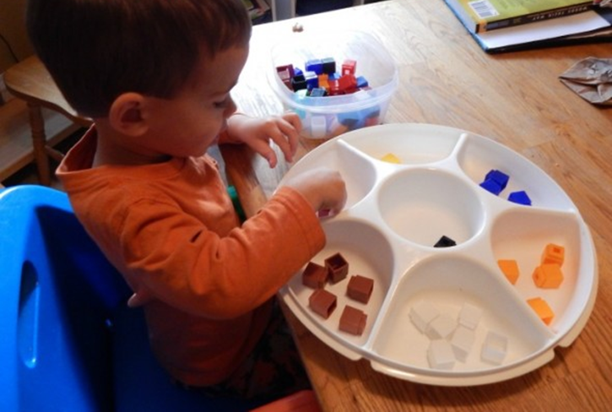
Activities
Count anything and everything
Sort objects
Estimate

Slide 11
More activities
Play “eye spy for numbers or go on a number hunt around the house. There are numbers everywhere; keyboards, clocks, calendars, microwaves, and many more places if you search.
Sort objects. Just about anything can be sorted, even laundry. Sort in many ways by color, shape and size.
Sort by attributes such as vehicles by mode of transportation ( travels by air, water or land ). Sort bugs by the amount of legs they have or if they do or do not fly.
Estimating is also known as guessing. Play games by asking children to guess how many “items” you have in your hands or in a jar. After they guess, do the actual count.
Transferring water using several sized containers is a fun estimating game. Ask questions such as; “how many scoops using this container would fill that container?”
Remember to guess in advance then do the actual count, Note, it’s not about guessing the correct number, it’s about getting familiar with numbers and concept of more or less.

Slide 12
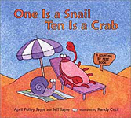
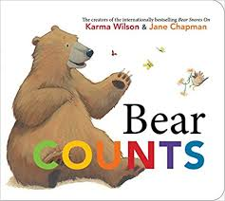
There are many choices of books related to number sense and numeration there are also many songs and finger plays
One Is a Snail Ten Is a Crab,
by Randy Cecil, Jeff Sayre, and April Pulley Sayre
Bear COUNTS,
by Suse MacDonald

Slide 13
Measurement
Finding the length,
height and weight
of an object
13

Slide 14
By the end of Early Learning Kindergarten, children will:
Measure and compare length, mass, capacity, area, temperature, and the passage of time using non-standard and standard units through free exploration, focused exploration, and guided activity
Compare and place in order two or more objects according to an appropriate measure (e.g., length, mass, temperature, capacity) and use measurement terms (e.g., hot/cold for temperature, small/medium/ large for capacity, longer/shorter or thicker/thinner for length)
Investigate non-standard measuring devices (e.g., feet, hand spans, string or blocks to measure length; hand claps to measure time; scoops of water or sand to measure capacity)
Investigate standard measuring devices (e.g., measuring cups, balance scales and measuring tapes)

Slide 15
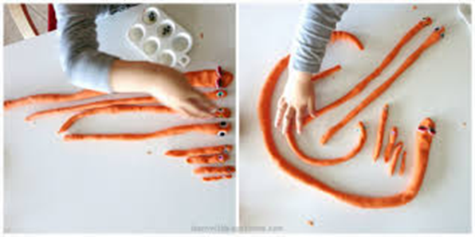
Activities
Use standard and non-standard units to measure
Use simple measurement terms
Compare two or more objects

Slide 16
More activities
Children must go through a number of stages before they can measure using standard units such as, (cm. meters, or inches).
First, they need to understand the use non-standard units to measure. Practice by using a variety of things to measure with (e.g., blocks, bears, hands, etc).
Compare things, for example “the table is bigger than my bear” or “find something smaller than the bear”.
* It is important to use the language of measurement.
Measure things with hands, bears, blocks… and ask:
How many hands tall are you?
How many blocks do you need to reach the height of the table?
Find things taller (longer) or shorter than your bear?
Measure mass by comparing for example rocks (which feels heavier or lighter).
Cooking and baking are rich math activities that provide opportunities to use measurement language.
There are lots of great playdough recipes and playdough is great for measuring,

Slide 17
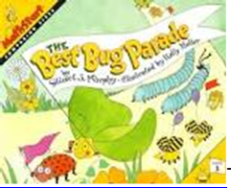
Books related to measurement
The Bug Parade,
by Stuart J Murphy
Just a Little Bit,
by Ann Tompert

Slide 18
Spatial sense
and
geometry
Describes and classifies,
the physical world in which we live
18

Slide 19
By the end of Early Learning Kindergarten, children will:
Describe, sort, classify, build, and compare two-dimensional shapes and three-dimensional figures such as cones and triangles or a cube vs a square
Describe the location and movement of objects through investigation
Compose pictures and build designs, shapes, and patterns, using two-dimensional shapes
Understand and build three dimensional structures using a variety of materials
Demonstrate basic spatial relationships and movements. Use vocabulary such as above/below, near/far, in/out.

Slide 20
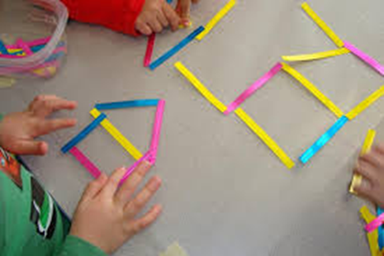
Activities
Identify and describe different shapes
Use language to describe basic spatial relationships

Slide 21
More activities
Identify and sort a set of 2 dimensional objects (e.g., circle, square, rectangle)
Identify and sort 3 dimensional objects (e.g., can, ball, block, cones)
Match a real object to a picture
Puzzles are great. You can make your own by cutting up the front of a cereal box or any other picture
Use language accurately to describe basic spatial relationships (e.g., above, below, near/far, in/out)
You can play this simple game with any object (e.g., put the dinosaur on your head, put it under your feet, behind your back, in front of you etc.)

Slide 22

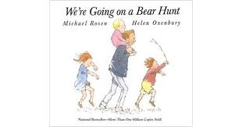
Books related to geometry and spatial sense
Shape by Shape,
by Suse MacDonald
We're Going on a Bear Hunt,
by Michael Rosen, Author, Helen Oxenbury, Illustrator Margaret K. McElderry

Slide 23
Understand and recognize patterns
Patterning
23

Slide 24
By the end of Early Learning Kindergarten, children will;
Explore, recognize, describe, and create patterns using a variety of materials in different contexts.
Identify, create, reproduce, and extend repeating patterns through investigation
Identify and describe informally the repeating nature of patterns (e.g., patterns in nature, clothing, floor tiles, literature, schedules)
Use verbal expressions (e.g., “goes before”, “goes after”, “morning, noon, night”, “the four seasons”)

Slide 25
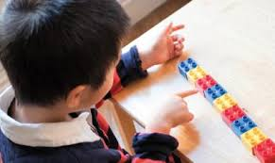
Activities
Identify and reproduce simple patterns.
Create and extend simple patterns.
Make predictions

Slide 26
More activities
Stages of learning patterns;
  Children recognize and identify patterns. Help children say the pattern (red-blue-red-blue). Talk about the pattern rule.
  After children can identify the pattern rule, they will be able to reproduce (copy) a pattern. You make a pattern; they make the same pattern or match the pattern.
  Extending the pattern. Children should be able to continue the pattern by saying what comes next (predicting).
  Children can create their own simple pattern and say the pattern rule.
*All stages progress from simple to complex and need lots of practice.
Use anything to make patterns (e.g., buttons, pom-poms, shapes, clothes pins, straws, toothpicks, stringing beads, toys, bottle tops, buttons, toothpicks) and actions (e.g., physical actions such as clapping, jumping, tapping).

Slide 27
Books related to patterning
A Pair of Socks,
by Stuart J Murphy, illustrated by Lois Ehlet
Mouse Count,
by Ellen Walsh

Slide 28
Ability to collect, organize and interpret information
Data Management
and
Probability
28

Slide 29
By the end of Early Learning Kindergarten, children will;
Sort, classify, and display a variety of concrete objects, collect data, begin to read and describe displays of data, and begin to explore the concept of probability in everyday contexts
Sort, classify, and compare objects and describe their attributes
Collect objects and data and make representations of their observations using concrete graphs
Use mathematical language in informal discussions to describe probability

Slide 30
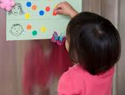
Activities
Activities
Ability to collect,
Organize and interpret
information

Slide 31
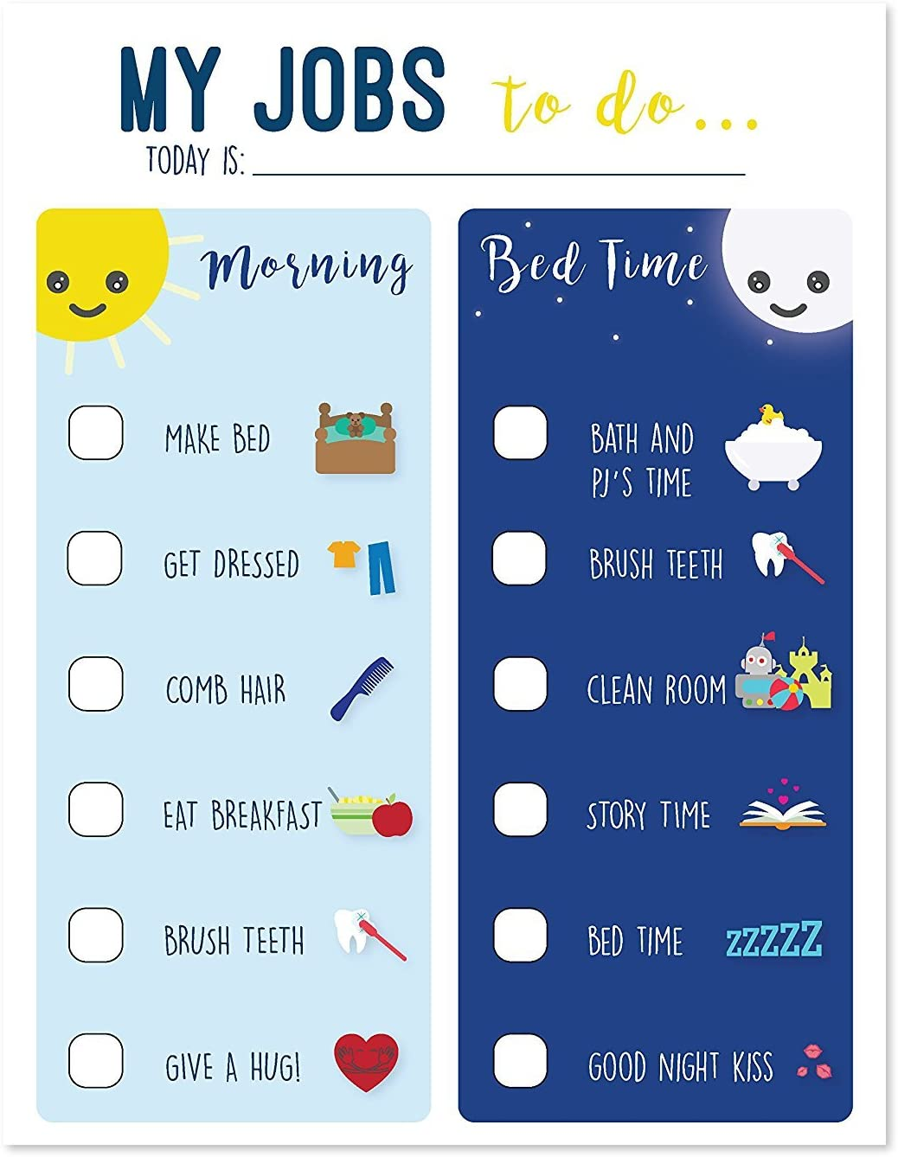
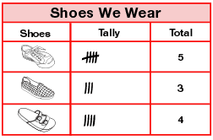
Activities
Use charts and graphs
Use the language of
probability

Slide 32
More activities
Create charts - routine charts (e.g., bedtime)
Sorting charts - from a pile of footwear, create a chart of boots, shoes and sandals. Draw a mark on the chart in the correct block for each piece of footwear. By looking at the chart, what type of footwear do we have most of? Or Less of?
Use simple grids correctly (e.g., in games such as bingo, tick-tack-toe)
Use language of probability (e.g., chance, might, luck)

Slide 33
Books related to data management and probability
Follow That Map!
by Scot Ritchie
If You Give a Moose a Muffin,
by Laura Numeroff

Slide 34
Children learn,
at their own pace !!
By Doing
By Repeating
By Asking questions and solving problems
By Having fun

Slide 35
Math is Everywhere
Math is more than working with numbers. It involves many strands that overlap and interact.
Math is all around us. It’s in the home, outside and in our community.
We can help children learn math with a combination of taking advantage of everyday situations (teachable moments) as well as by carefully planning activities and focusing on a particular strand or concept.
No matter the case, remember to keep it fun and that each child is unique. Children learn at their own pace!

Slide 36
References
Adams, L., Waters, J., Chapple, N., & Onslow, B. (2002). Esso Family Math Resources for JK, K & Grade 1 Children and their Parents. London: Faculty of Education The University of Western Ontario.
Education, Ministry of. (2010). The Full-Day Early Learning-Kindergarten Program Draft version. Toronto: Queen's Printer of Ontario.
(Early Learning for Every Child Today, A framework for Ontario early childhood settings,2007)

Slide 37
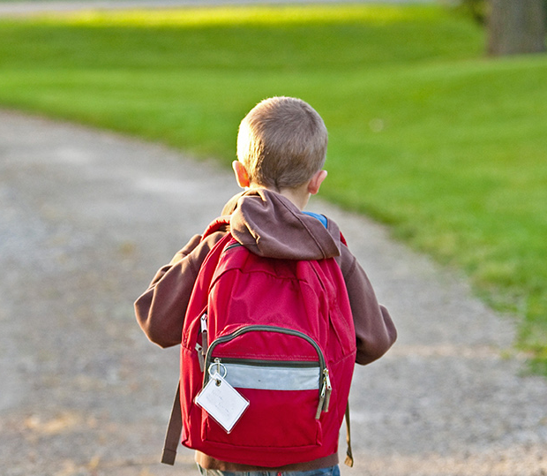
Thank You!
Sharlene Trottier RECE &
Karen Brown RECE
37

